Slide 1
Introduction and Quantitative Analysis
Classes of Computers
Various Trends
Measuring and Reporting Performance
Quantitative Principles of Computer Design

Slide 2

Measuring, Reporting and Summarizing Performance
Response time is the time between the start and completion of an event
Execution time
Throughput is the total amount of work done in a given time
Relative performance
X is (n times) faster than Y
n = (Execution time of Y) / (Execution time of X)
= (Performance of X) / (Performance of Y)
A number of metrics are used for comparing performance
Execution time is defined in a number of ways
Wall clock time, response time or elapsed time
Latency to complete a task

Slide 3
Measuring, Reporting and Summarizing Performance
CPU time is the time when the CPU is computing that does not include the time waiting for I/O and other such activities
Response time seen by the user is the elapsed time
Computer users who routinely use the same programs are the best candidate for evaluating the performance of a new computer
Compare the execution time of their workloads
The mixture of programs and operating system commands that users run on a computer
Not all users may have this option and must rely on others

Slide 4
Measuring, Reporting and Summarizing Performance
Benchmarks
The best choice of benchmarks to measure performance are real applications
Other choices have proved to be less accurate
Kernels
Small, key pieces of real applications
Toy programs
About 100 lines of code from the beginning programming assignments
Synthetic Benchmarks
Programs written to try to match the profile and behavior of real applications
All three are not credited because these can be engineered

Slide 5
Measuring, Reporting and Summarizing Performance
Issues with real applications
Conditions under which the benchmarks are run
Whether source code modifications are allowed
There are three approaches to address this issue
No source code modifications are allowed
Source code modifications are allowed, but are essentially impossible
Source code modifications are allowed, as long as the modified version produces the same output
Benchmark suites
Collections of benchmark applications
Weakness of any one benchmark is lessened by the presence of other benchmarks
Characterizes the relative performance of computers

Slide 6
Measuring, Reporting and Summarizing Performance
An example benchmark suite is the Electronic Design News Embedded Microprocessor Benchmark Consortium (EEMBC)
Set of 41 kernels used to predict the performance of different embedded applications
Automotive/Industrial Consumer
Networking Office Automation
Telecommunications
Not considered to be a good predictor of performance
SPEC (Standard Performance Evaluation Corporation) is one of the most successful attempts to create standardized benchmark application suites
Evolved for workstations

Slide 7
Measuring, Reporting and Summarizing Performance
Desktop Benchmarks
Processor-intensive and graphics-intensive benchmarks
SPEC CPU 2017
Set of10 integer (CINT 2017) and 17 floating- point (CFP 2017) benchmarks
Real programs modified for portability and to minimize the effect of I/O on performance
Designed to measure processor performance
Server Benchmarks
Multiple types of benchmarks depending on the functions performed by the server
Processor throughput-oriented benchmark
SPEC rate
Measures the processing rate of a multiprocessor by running multiple copies of SPEC benchmark
Notes:
SPEC89, SPEC92, SPEC95, SPEC2000, SPEC2006, SPEC2017
See Figure 1.18 for details of the programs included in the suite
PARSEC benchmarks for parallel applications – Princeton application repository for shared memory computers

Slide 8
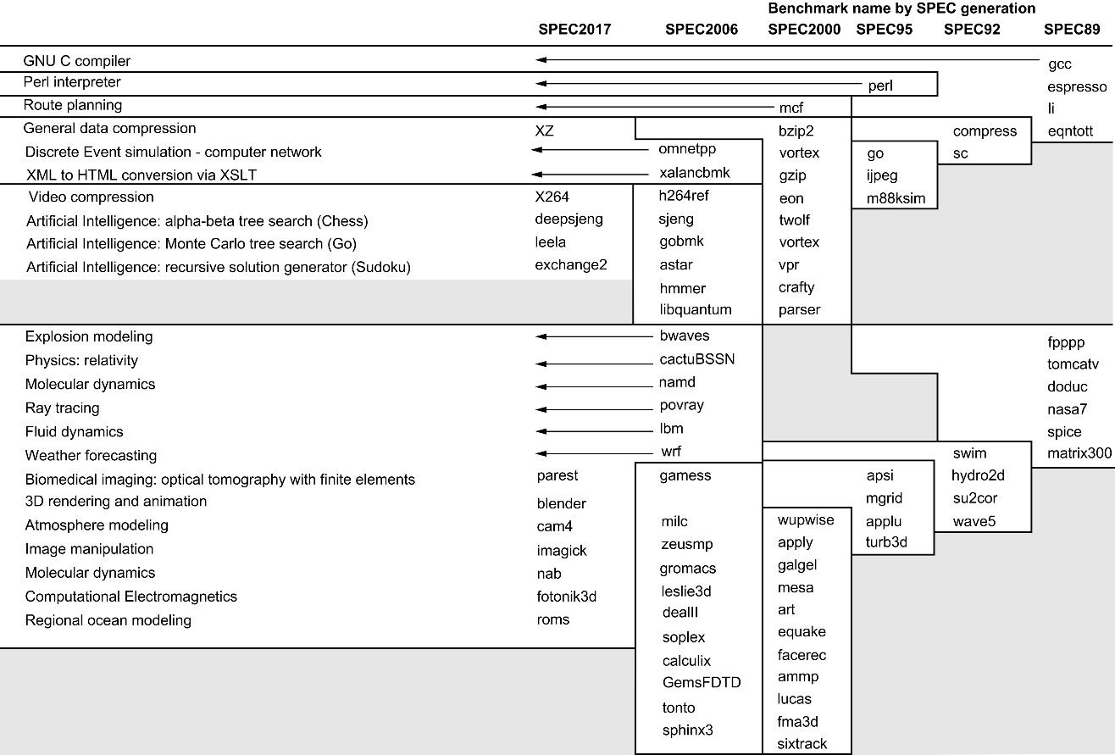

Slide 9
Measuring, Reporting and Summarizing Performance
SPECFS (File-server benchmark) and SPECWeb (Web-server benchmark) are the application benchmarks for benchmarking I/O activities
TP (Transaction processing) benchmarks measures the ability of a system to handle transactions
TPC (Transaction Processing Council) create benchmarks for TP
Reporting Performance Results
Guiding principle should be reproducibility
List everything another experimenter would need to replicate the results
This should include Hardware, Software, Tuning parameters, etc.
Summarizing Performance Results
Reading assignment

Slide 10
Introduction and Quantitative Analysis
Classes of Computers
Various Trends
Measuring and Reporting Performance
Quantitative Principles of Computer Design

Slide 11
Quantitative Principles of Computer Design
Explore guidelines and principles that are useful in the design and analysis of computers
Take Advantage of Parallelism
One of the most important methods for improving performance
Three examples
Use of parallelism at system level
Use multiple processors and multiple disks in servers
Scalability is important for servers
Parallelism among instructions in individual processor
Pipelining: Overlap instruction execution to reduce the total time to complete a sequence of instructions

Slide 12
Quantitative Principles of Computer Design
Parallelism at the level of detailed digital design
Set associative cache using multiple banks to facilitate search simultaneously
Parallelism in addition operation through
Carry lookahead adders
Principle of Locality
An important fundamental observation that has come from the properties of programs
A program tends to reuse data and instructions they have used recently
Rule of thumb
A program spends 90% of its execution time in only 10% of its code
Temporal and spatial locality

Slide 13
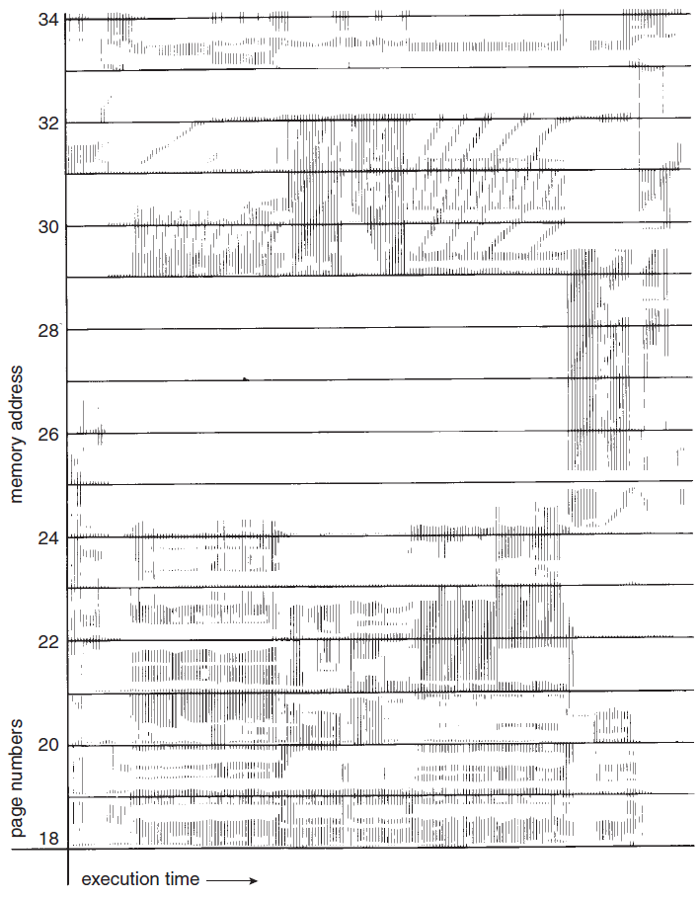
Locality In Memoryreferen-ce Pattern
Notes:
13

Slide 14
Quantitative Principles of Computer Design
Focus on the Common Case
Favor frequent case over the infrequent case
Frequent case is often simpler and faster
Quantify the principle and determine what the frequent case is
Amdahl’s Law can be used to quantify this principle
Amdahl’s Law
The performance improvement to be gained from using some faster mode of execution is limited by the fraction of the time the faster mode can be used
Defines the speedup that can be gained by a particular feature
Notes:
Overflow during addition

Slide 15
Quantitative Principles of Computer Design
Speedup =
Performance for entire task using the enhancement when possible Performance for entire task w/o using the enhancement
Speedup =
Execution time for entire task w/o using the enhancement
Execution time for entire task using the enhancement when possible
Speedup depends on two factors:
Fraction of computation time in the original machine that can be converted to take advantage of the enhancement
This value is Fraction_{enhanced} that is always less than or equal to 1
The improvement gained by the enhanced execution mode
This value is the Speedup_{enhanced} that is always greater than 1

Slide 16
Quantitative Principles of Computer Design
Execution time _{new} =
Execution time _{old} x ((1 – Fraction_{enhanced}) + Fraction _{enhanced} ) Speedup _{enhanced}
Speedup _{overall} = Execution time _{old}
Execution time _{new}
= _______1_______________________
(1 – Fraction_{enhanced}) + Fraction _{enhanced}
Speedup _{enhanced}
Amdahl’s Law expresses the law of diminishing returns
“The incremental improvement in the performance of just a portion of computation diminishes as improvements are added”

Slide 17
Quantitative Principles of Computer Design
An important corollary:
“If an enhancement is only usable for a fraction of a task, we cannot speed up the task by more than the reciprocal of one minus that fraction”
Amdahl’s Law is useful in the design and evaluation of various architecture of processors and enhancements that are added from time to time
It is used to compare overall system performance of two or more alternatives
Floating Point unit design alternatives
Web server design alternatives
Measurements of the fraction of time for new and improved version directly is difficult

Slide 18
Quantitative Principles of Computer Design
The Processor Performance Equation
Processors are running with clock time, clock periods, clocks, or clock cycles
CPU time for = CPU clock cycles for a program
a program clock rate
= CPU clock cycles for a program x clock cycle time
Count the number of instructions executed (IC)
Calculate the average number of clock cycles per instruction (CPI), where
CPI = CPU clock cycles for a program
Instruction count
This figure provides insight into different styles of instruction sets and implementations
CPU time = IC x Clock Cycle time x CPI
OR CPU time = IC x CPI
Clock rate

Slide 19
Quantitative Principles of Computer Design
CPU performance depends on all three factors
It is difficult to change one of the factors in isolation
Clock cycle time is dependent on
Hardware technology and organization
CPI is dependent on
Organization and instruction set architecture
IC is dependent on
Instruction set architecture and compiler technology
It is often possible to measure the components of the processor performance equation
It is more difficult to calculate CPI
Most new processors have counters to count the number of instructions executed and the number of clock cycles

Slide 20
Putting It All Together
Performance, Price and Power
Real examples that use the principles given in that chapter
Measures of performance and power-performance in small servers using SPECpower benchmark
Three multiprocessor servers are evaluated along with their prices
The result is reported in the form of a table and illustrated with a graph
The results, the analysis of results, reporting of results and the derived conclusions
Reading assignment

Slide 21
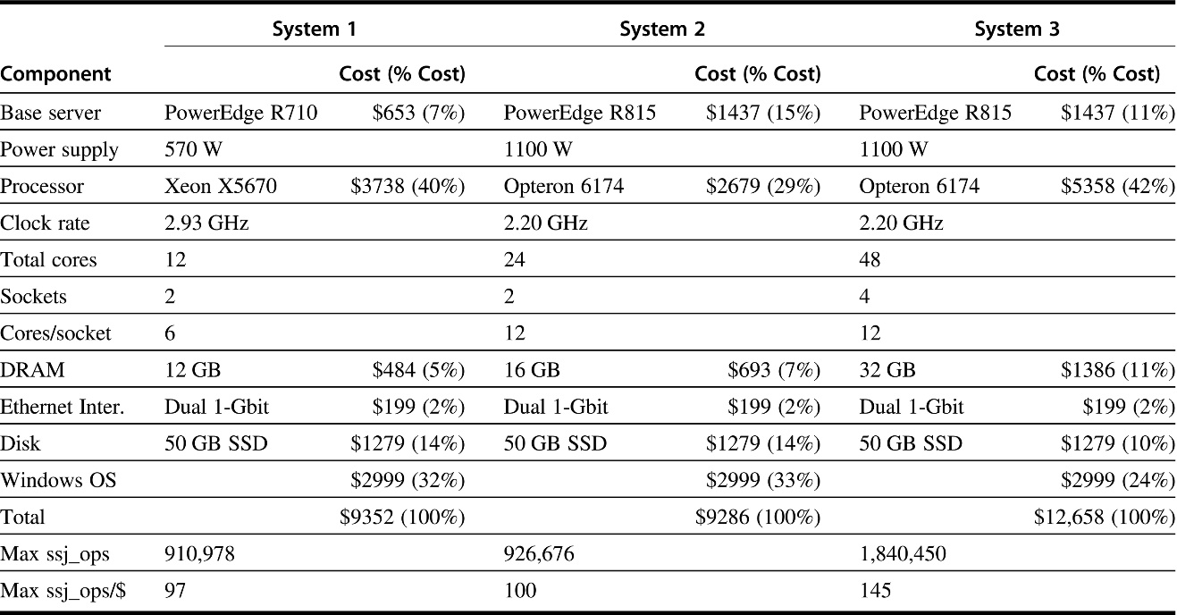
Dell PowerEdge Servers compared

Slide 22
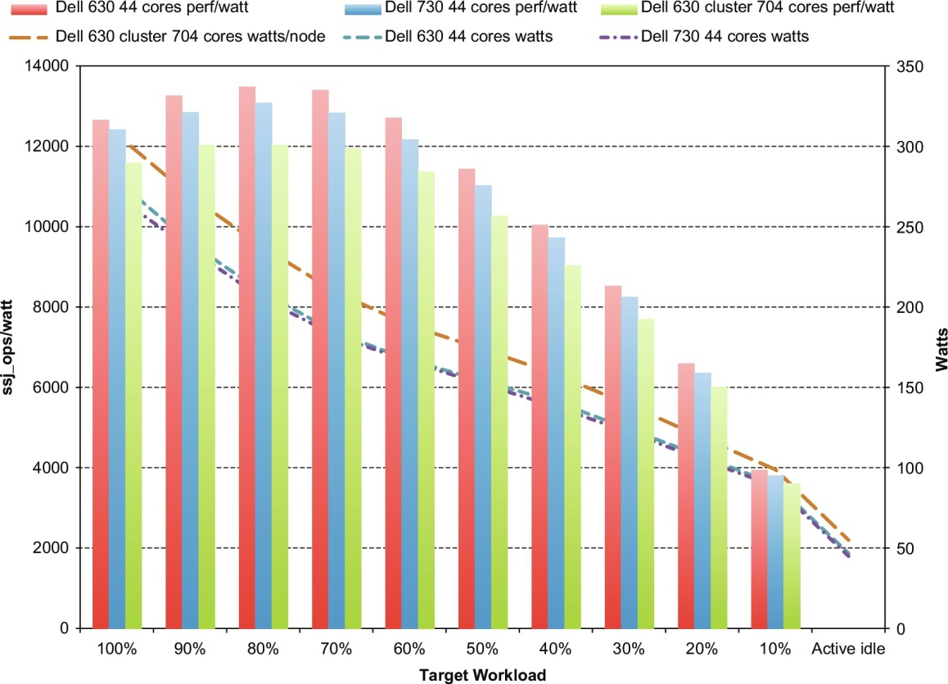
Power Performance

Slide 23
Fallacies and Pitfalls
Commonly held misbeliefs or misconceptions that one should avoid
Fallacies refer to misbeliefs or misconceptions
Counter examples are given to clarify
Pitfalls refer to easily made mistakes
Generalizations of principles that are true in a limited context only
Pitfall All exponential laws must come to an end
Dennard scaling: Power density remains constant as transistors get smaller
Chips used the same power although operated faster
Dennard scaling ended around 2004
Static power became a significant fraction of the overall power

Slide 24
Fallacies and Pitfalls
There is a reduction of areal density of hard drives, thus reducing the rate of increase of capacity
Recently reduced to 5% per year from 30%
Rate of increase in number of transistors according to Moore’s law is not valid anymore
Number of transistors per chip does not double every one to two years
Fallacy Multiprocessors are a silver bullet
Switch to multicore processors was because there was no other option
ILP wall and power wall were the main reasons
Exploitation of this parallelism to gain performance is the programmer’s burden
They must make their programs more parallel

Slide 25
Fallacies and Pitfalls
Pitfall Falling prey to Amdahl’s Law
Spending tremendous effort in optimizing some aspects of an architecture without measuring its usage
Pitfall A single point of failure
In fault-tolerant systems
Every component should be made redundant so that no single component failure can bring down the whole system
Fallacy Benchmarks remain valid indefinitely
Usefulness of a benchmark depends on
Its ability to resist “benchmark engineering”
Targeted optimizations are attempted to show better results from a benchmark program

Slide 26
Fallacies and Pitfalls
Fallacy Peak performance tracks observed performance
Peak performance is the performance level a computer is guaranteed not to exceed
Not useful to predict observed performance
Pitfall Fault detection can lower availability
Sometimes detection of faults does not require to halt the system
Some faults allow to continue with degraded performance but correct operations
Others require to correct the fault to gain from the scheme
Concluding Remarks
Reading assignment

Slide 27

Instruction Set Principles Appendix A
Classifying ISA
Design alternatives available to the instruction set architect
Role of Compiler
The RISC-V ISA

Slide 28
Instruction Set Principles and Examples
Introduction
Focus on various ISA alternatives
Portion of the computer visible to the programmer or the compiler writer
Taxonomy of Instruction Set alternatives and qualitative assessment of the advantages and disadvantages of various approaches
Analysis of some instruction set measurements that are independent of a specific instruction set
Issues of language and compilers and their effect on ISA
Ideas “Put together” and reflected in the form of RISC-V instruction set
Fallacies and pitfalls of instruction set design

Slide 29
Introduction
All architectural measurements are dynamic
Program size is not important in Desktop computing
Floating point performance is less important in servers
Cost and energy is valued in personal mobile devices and embedded applications
Code size is important
Some instruction classes may be omitted
RISC-V is used to illustrate the RISC advantages
80x86 – A successful architecture
Uses RISC instruction set internally
Supports 80x86 instruction set externally
How instruction set architectures can be classified

Slide 30
Instruction Set Principles and Examples
Classifying Instruction Set Architectures
Type of internal storage in a processor is the main differentiating factor
Major choices
Stack
Operands are implicitly on the top of the stack
Accumulator
One operand is implicitly the accumulator
General purpose register architecture
Only explicit operands
Registers or memory locations
Registers are faster than memory
Easier for a compiler to use

Slide 31
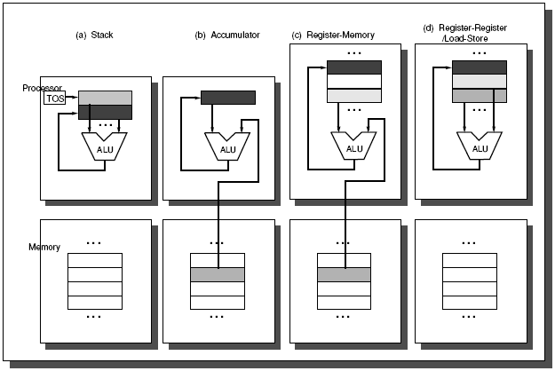
Operand locations for four ISA classes

Slide 32
Classifying Instruction Set Architectures
Classes of GPR Machines
Register – Register (load/store)
Register – Memory
Memory – Memory
Factors that affect the classification
How many registers are sufficient?
Depends on the effectiveness of the compiler
Compilers use registers for
Expression evaluation
Parameter passing
Allocated to hold variables
Register counts have increased in recent architectures
GPR architecture with load/store version

Slide 33
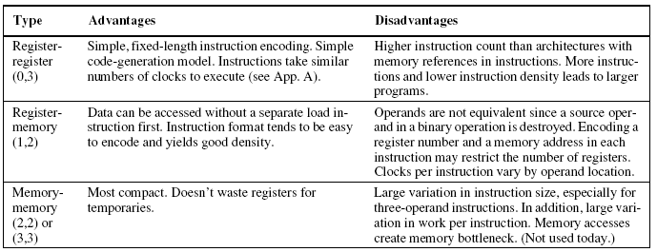
Advantages and disadvantages of the three most common types of GPR computers

Slide 34
Instruction Set Principles and Examples
Memory Addressing
How memory addresses are interpreted and how are these specified?
Interpreting memory addresses
Byte Addressing is used
Access is for
Bytes, Halfword(HW), Word (W) and Doubleword (DW)
Ordering of bytes within a word
Little Endian
Puts the byte with address x..x000 at the least significant position in the double word
DEC VAX, RISC, Intel
Address of the data is the address of the LSB

Slide 35
Memory Addressing
Big Endian
Puts the byte with address x..x000 at the most significant position in the double word
IBM 360, Motorola 680x0
Address of data is the address of the MSB
Aligned and misaligned accesses to data
Why is alignment necessary?
Addressing Modes
How architectures specify the address of the objects they access
A constant
A register
A location in memory

Slide 36
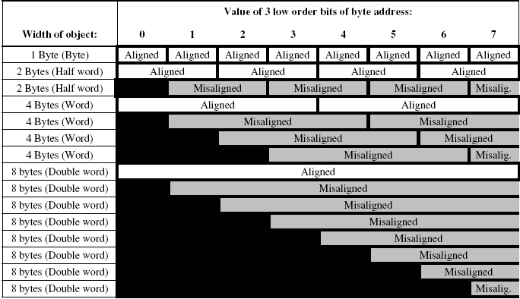
Aligned and misaligned addresses for byte addressed computers

Slide 37
Memory Addressing
Effective address is the address of a location in memory
List of addressing modes
Addressing modes reduce Instruction Counts (IC)
They add to the complexity of the computer
Increases average Clock-cycles Per Instruction (CPI)
Usage of addressing modes in VAX architecture
Displacement Addressing Mode
Major question is the range of displacements used
Widely distributed values
Large number of smaller displacements
A fair number of larger displacements
Most displacements are positive

Slide 38
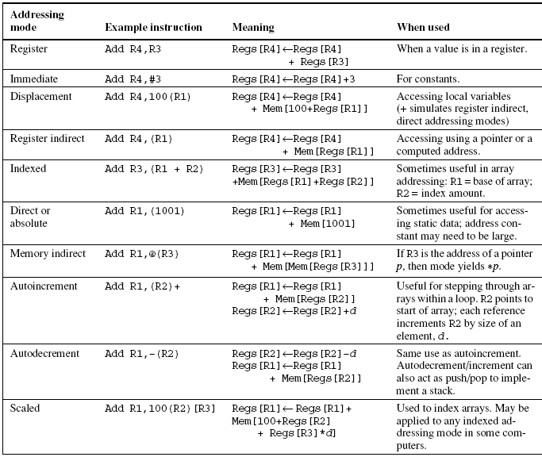
Selection of addressing modes

Slide 39
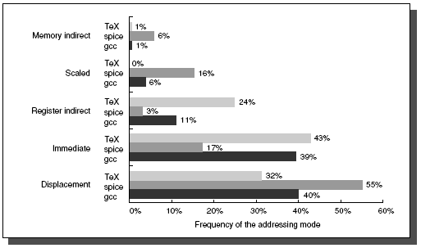
Summary of the use of memory addressing modes

Slide 40
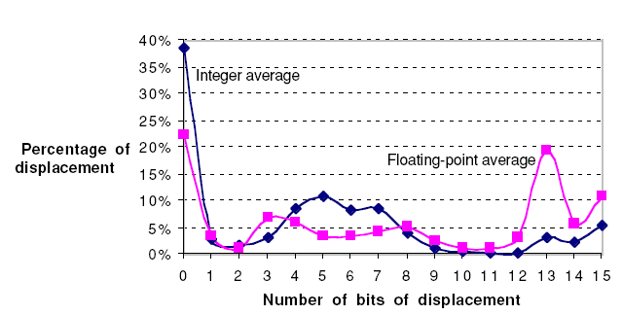
Widely Distributed Displacement Values

Slide 41
Memory Addressing
Majority of largest displacements are negative
Benchmarks give an insight about the size of the displacement field
Immediate or Literal Addressing Mode
Immediate operands are used in
Arithmetic operations
Comparison Operations
Moves with constants
25% of ALU and data transfer operations use immediate operand
Size of immediate value affects the instruction length
Small values are used more frequently

Slide 42
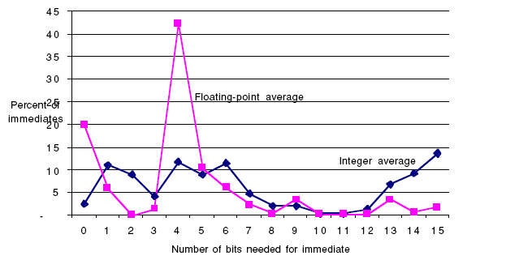
The Distribution of Immediate Values

Slide 43
Memory Addressing
Summary: Memory Addressing
A new architecture should at least support the following addressing modes
Register, Displacement, Immediate and Register Indirect Modes
Represent 75% to 99% addressing modes used
Size of the displacement field
At least 12 to 16 bits
Captures 75% to 99% of the displacements
Size of immediate field
At least 8 to 16 bits

Slide 44
Instruction Set Principles and Examples
Type and Size of operands
How is the type specified in instructions? Two options:
Encoding the type of operand in the op-code is the most used method
Tags can be attached to data that can be interpreted by the hardware
Tagged data computers are obsolete
Common operand types
Byte
Half-word (HW)
Word (W)
Single Precision Floating-Point
Double Precision Floating-Point
Distribution of data accesses

Slide 45
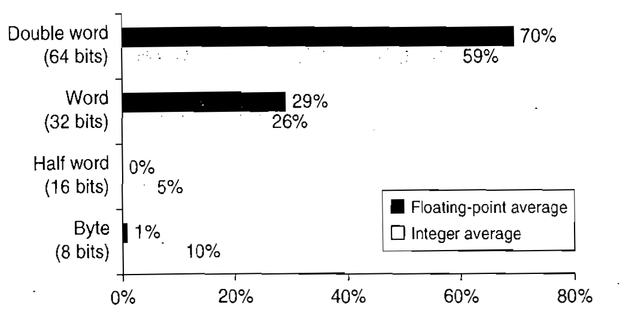
Distribution of data accesses by size for the benchmark programs

Slide 46
Instruction Set Principles and Examples
Signed Integers use 2’s complement notation
Characters use 8-bit ASCII code
16-bit Unicode is also becoming popular
Packed BCD may be supported for business applications
Operations in the Instruction Set
All operations are categorized into groups
Most widely used operations are simple
SPECint92 results
Instructions for Control Flow
Measurements for branch and jump behavior are independent of other measurements and applications

Slide 47
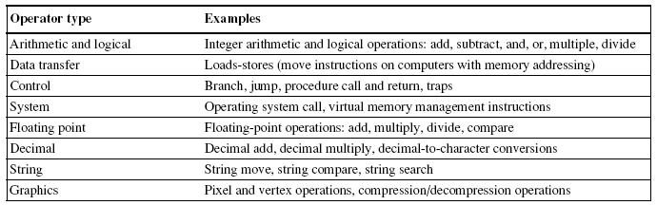
Categories of Instruction operators

Slide 48
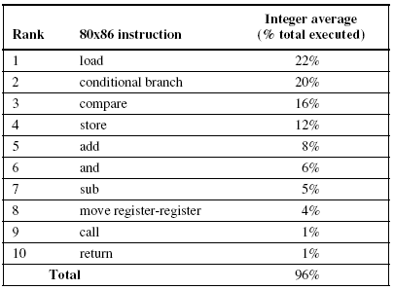
The top 10 instructions for 80x86

Slide 49
Instructions for Control Flow
Unconditional jump
Jump instruction
Conditional jump
Branch instruction
Four different types of control flow instructions
Conditional branches
Jumps
Procedure Calls
Procedure Returns
Relative Frequency of each of the above events
Conditional branches dominate with the highest frequency of occurrence

Slide 50
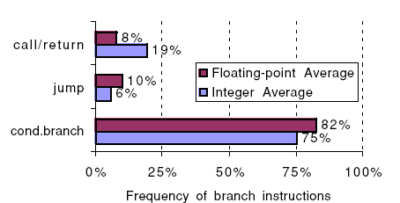
Breakdown of control flow instructions into three classes

Slide 51
Instructions for Control Flow
Addressing Modes for Control Flow Instructions
Specifying the destination address
PC-relative method
Provides position independence
For targets not known at compile time
Use register indirect addressing mode
Also useful for four other features
Case or switch statements of programming languages
Virtual functions or methods in object-oriented languages
High-order functions or function pointers in languages
Dynamically shared libraries
PC-relative target address: 4 to 8 bits
75% of all branch are in forward direction

Slide 52
Instructions for Control Flow
Conditional Branch Options
How to specify branch conditions?
Three techniques are used to specify branch condition
Properties of branch
A large number of comparisons are simple tests
A large number of comparisons are with zero
Frequency of different comparisons for conditional branch

Slide 53
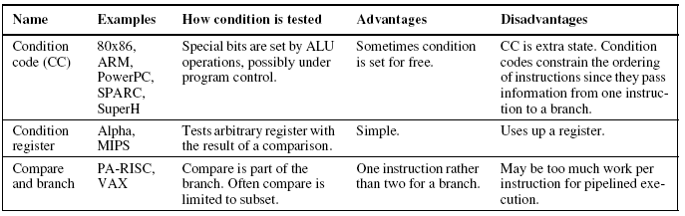
The major methods for evaluating branch conditions

Slide 54
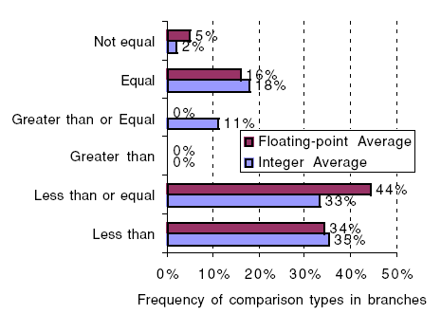
Frequency of different types of compares in conditional branches

Slide 55
Instructions for Control Flow
Procedure Invocation Options
Return Address?
Save in a special link register or save in a GPR or on runtime stack
Saving of other registers?
Caller saving or callee saving
Caller saving is required in case of shared global variables
Some programs will be more optimal with caller saving and some with callee saving
Summary: Instructions for Control Flow
One of the most frequently used instructions
Addressing modes added
Register indirect and PC-relative addressing mode with 8-bits displacement

Slide 56
Instruction Set Principles and Examples
Encoding an Instructions Set
Representation will affect
The size of a compiled program
Implementation of the processor
Large number of addressing modes require separate address specifier
For small number of addressing modes op-code can be used to encode the mode
Number of addressing modes and the number of registers have a significant impact on
Instruction length
Encoding
An architect must balance between several competing forces

Slide 57
Encoding an Instruction Set
Competing Forces
The desire to have as many registers and addressing modes as possible
The impact of (1) on the average instruction size
Instruction length should be easy to implement
Easily decodable
Encoded in multiples of bytes
Three popular choices for encoding of instruction sets
Variable length
Fixed length
Hybrid
Reduced Code Size in RISCs for embedded systems
Include both 16 and 32-bit instruction lengths
IBM uses compression techniques for storage in memory

Slide 58
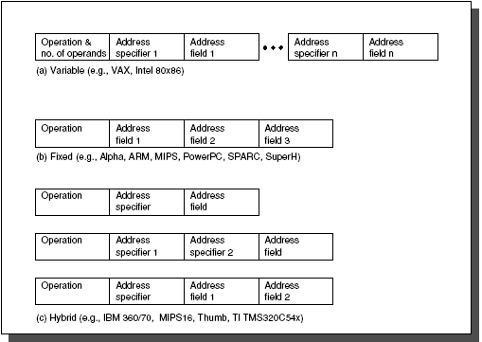
Three basic variations in instruction encoding

Slide 59
Instruction Set Principles and Examples
Summary: Encoding an Instruction Set
If code size is more important than performance, variable length encoding is preferable
If performance is more important than code size, fixed length instruction encoding is preferable
Cross-cutting Issues: The Role of Compilers
ISA is essentially a compiler target
What factors considered for ISA eases the job of a compiler writer?
The Structure of Recent Compilers
Optimizing compilers keep on optimizing the code as it goes through various passes

